Slide 1
Scientific English:
Writing concisely and clearly
4modIA
English
INSA Toulouse

Slide 2
The 3Cs in Scientific English
CLEAR
COHESIVE
CONCISE
INSA Toulouse

Slide 3
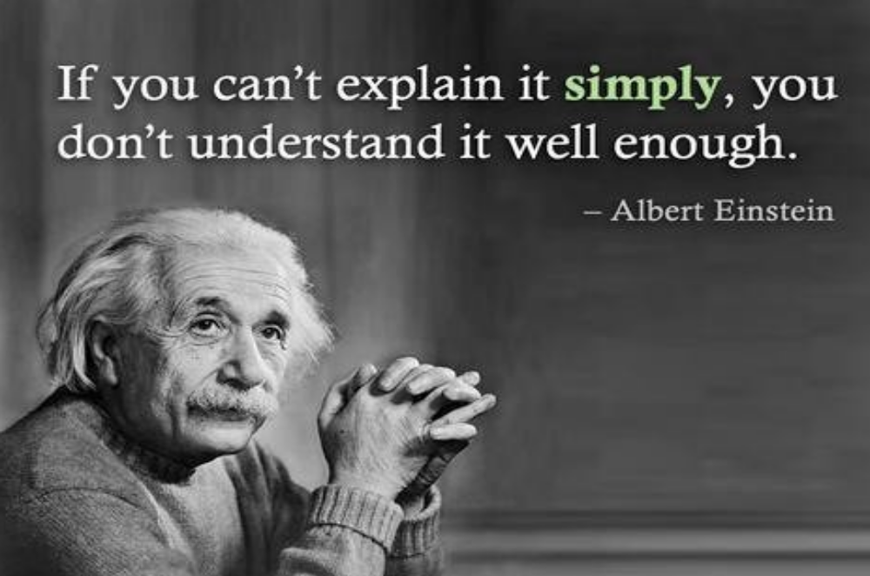
INSA Toulouse

Slide 4
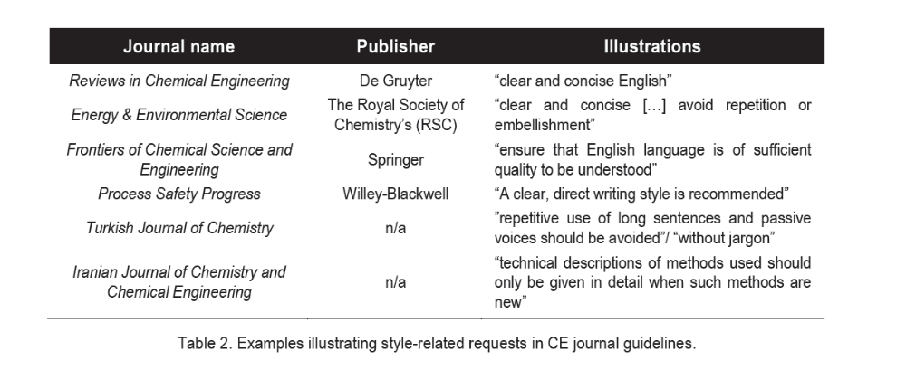
Your paper will be rejected if there is a lack of clarity or ambiguity, or if the text is not concise, not because of a few grammatical mistakes.
INSA Toulouse

Slide 5
Writing concisely
INSA Toulouse

Slide 6
Write concisely
Complex, long phrases will not make you sound more intelligent
Concise text your key ideas will stand out
your reader will quickly understand your text
Cut everything that is not essential …
Write using the simplest most direct terminology…
INSA Toulouse

Slide 7
To make your text more concise:
Avoid long sentences
Use simple words and phrases
Avoid redundancy: cut out redundant or repeated words/phrases
Avoid nominalisation! Use verbs not nouns
Use the active voice (personal or impersonal style)
INSA Toulouse

Slide 8
1. Use simple words and phrases
It is interesting to observe that… We have to point out that… It must be emphasised that… | Note that (for emphasis)
In the vast majority of cases… | Often
In close proximity to… | Close
Due to the fact that | Because (reduce number of link words)
In a rapid manner… For a conceptuel point of view | Rapidly (use adverbs, no adj+noun) Conceptually
☹
☺
INSA Toulouse

Slide 9
2. Avoid redundancy and repetition
Delete word(s) in a sentence – but the meaning of the sentence stays the same
Meetings will be held twice a year in June and December.
INSA Toulouse

Slide 10
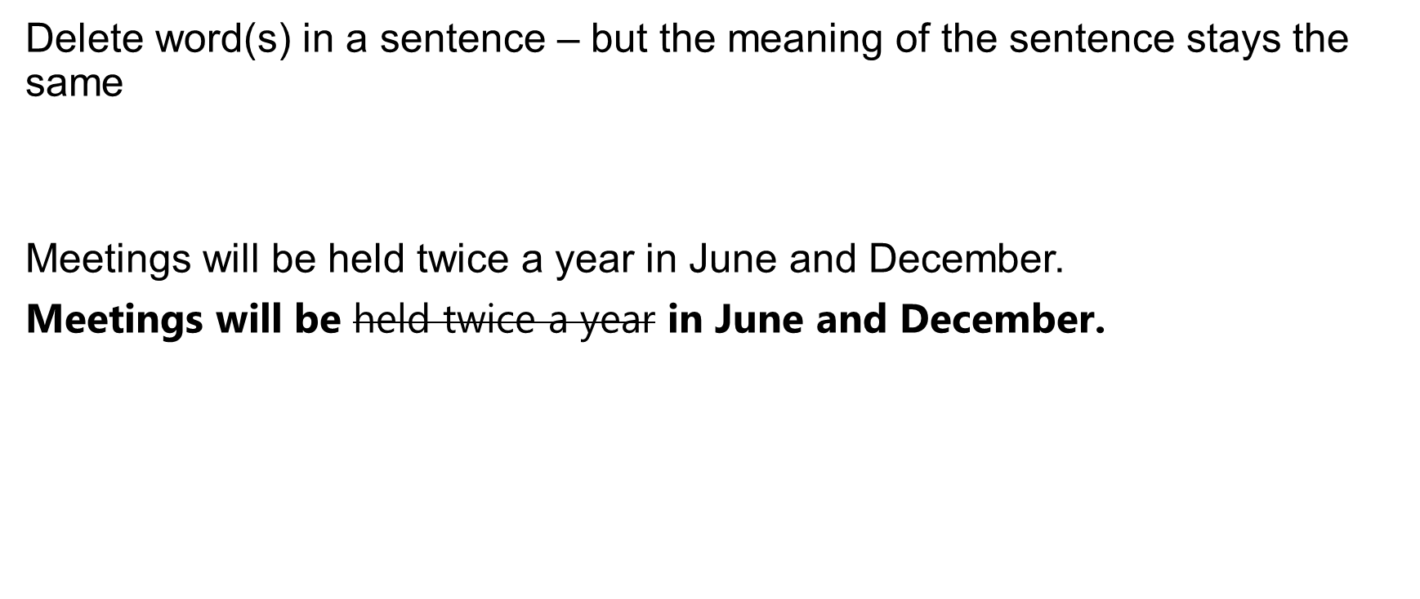
2. Avoid redundancy and repetition
INSA Toulouse

Slide 11
2. Avoid redundancy and repetition
Delete word(s) in a sentence – but the meaning of the sentence stays the same
The results obtained highlight that x = y.
INSA Toulouse

Slide 12
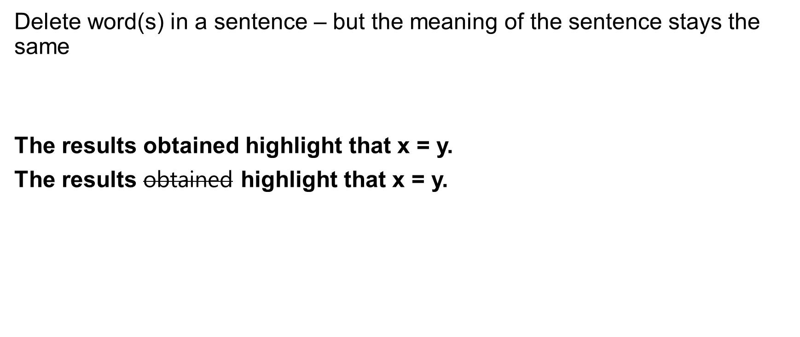
2. Avoid redundancy and repetition
INSA Toulouse

Slide 13
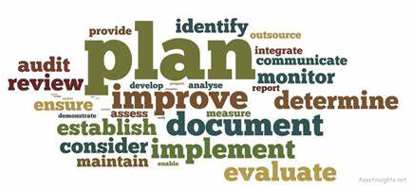
3. Avoid nominalisation. Use verbs not nouns!
Many verbs also have a noun form.
A common mistake is to use the noun form too frequently.
This can make your writing sound heavy.
INSA Toulouse

Slide 14
1. Identify the verb clauses
1a. Section 1: Choosing the notation
1b. Section 1: The choice of the notation
INSA Toulouse

Slide 15
1. Identify the verb clauses
1a. Section 1: Choosing the notation
1b. Section 1: The choice of the notation
INSA Toulouse

Slide 16
2a. Its solution typically requires considerable computational power.
2b. Considerable computational power is required to solve it.
INSA Toulouse

Slide 17
2a. Its solution typically requires considerable computational power.
2b. Considerable computational power is required to solve it.
INSA Toulouse

Slide 18
2. Verb + noun single noun
To reach a conclusion = to conclude
to achieve an improvement:
to carry out a test:
to cause an increase:
to effect a reduction:
to make a comparison:
to perform an installation:
INSA Toulouse

Slide 19
To reach a conclusion = to conclude
to achieve an improvement: to improve
to carry out a test: to test
to cause an increase: to increase
to effect a reduction: to reduce
to make a comparison: to compare
to perform an installation: to install
INSA Toulouse

